Slide 1
CAPTAIN STEEL PVT LIMITED
Presenting the TMT Bar manufacturing Process
Notes:
JOURNY TO “CAPTAIN TMT” MANUFACTURING PROCESS

Slide 2
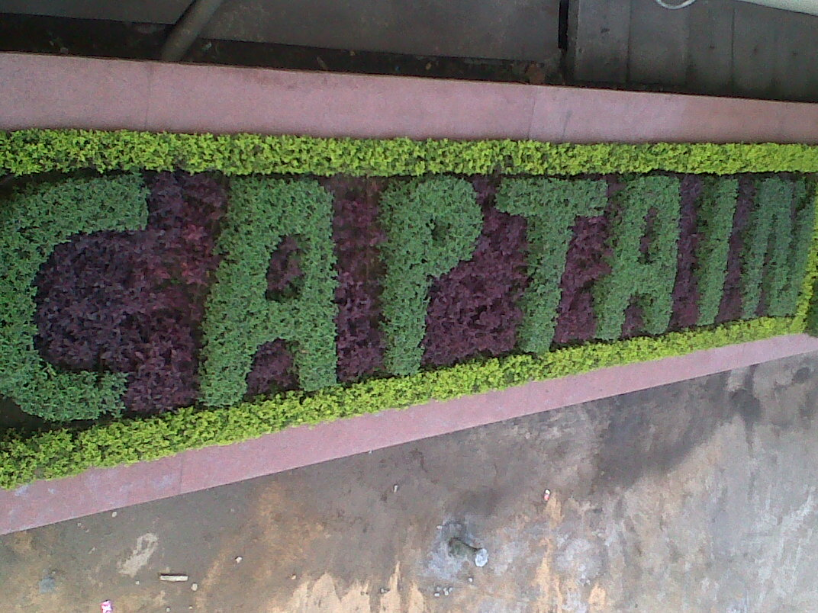

WELCOME TO CAPTAIN HOUSE

Slide 3
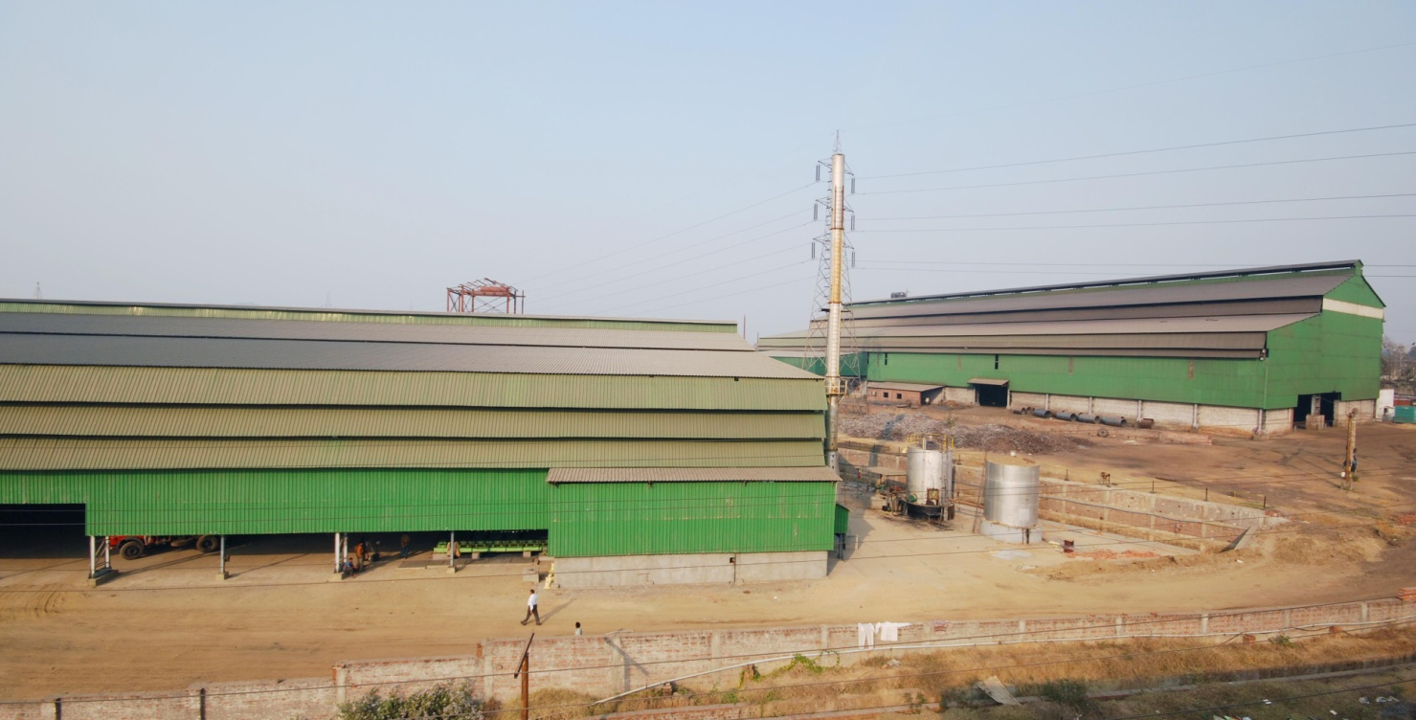
PLANT AT KADUWELLA & MALWANNA
LET US START A JOURNY TO “CAPTAIN TMT”
MANUFACTURING PROCESS

Slide 4
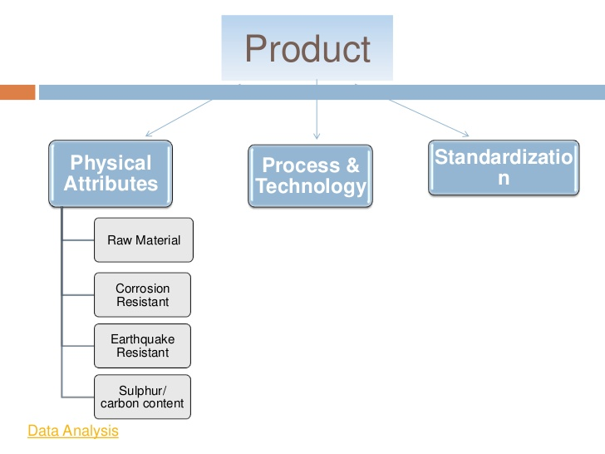

Slide 5
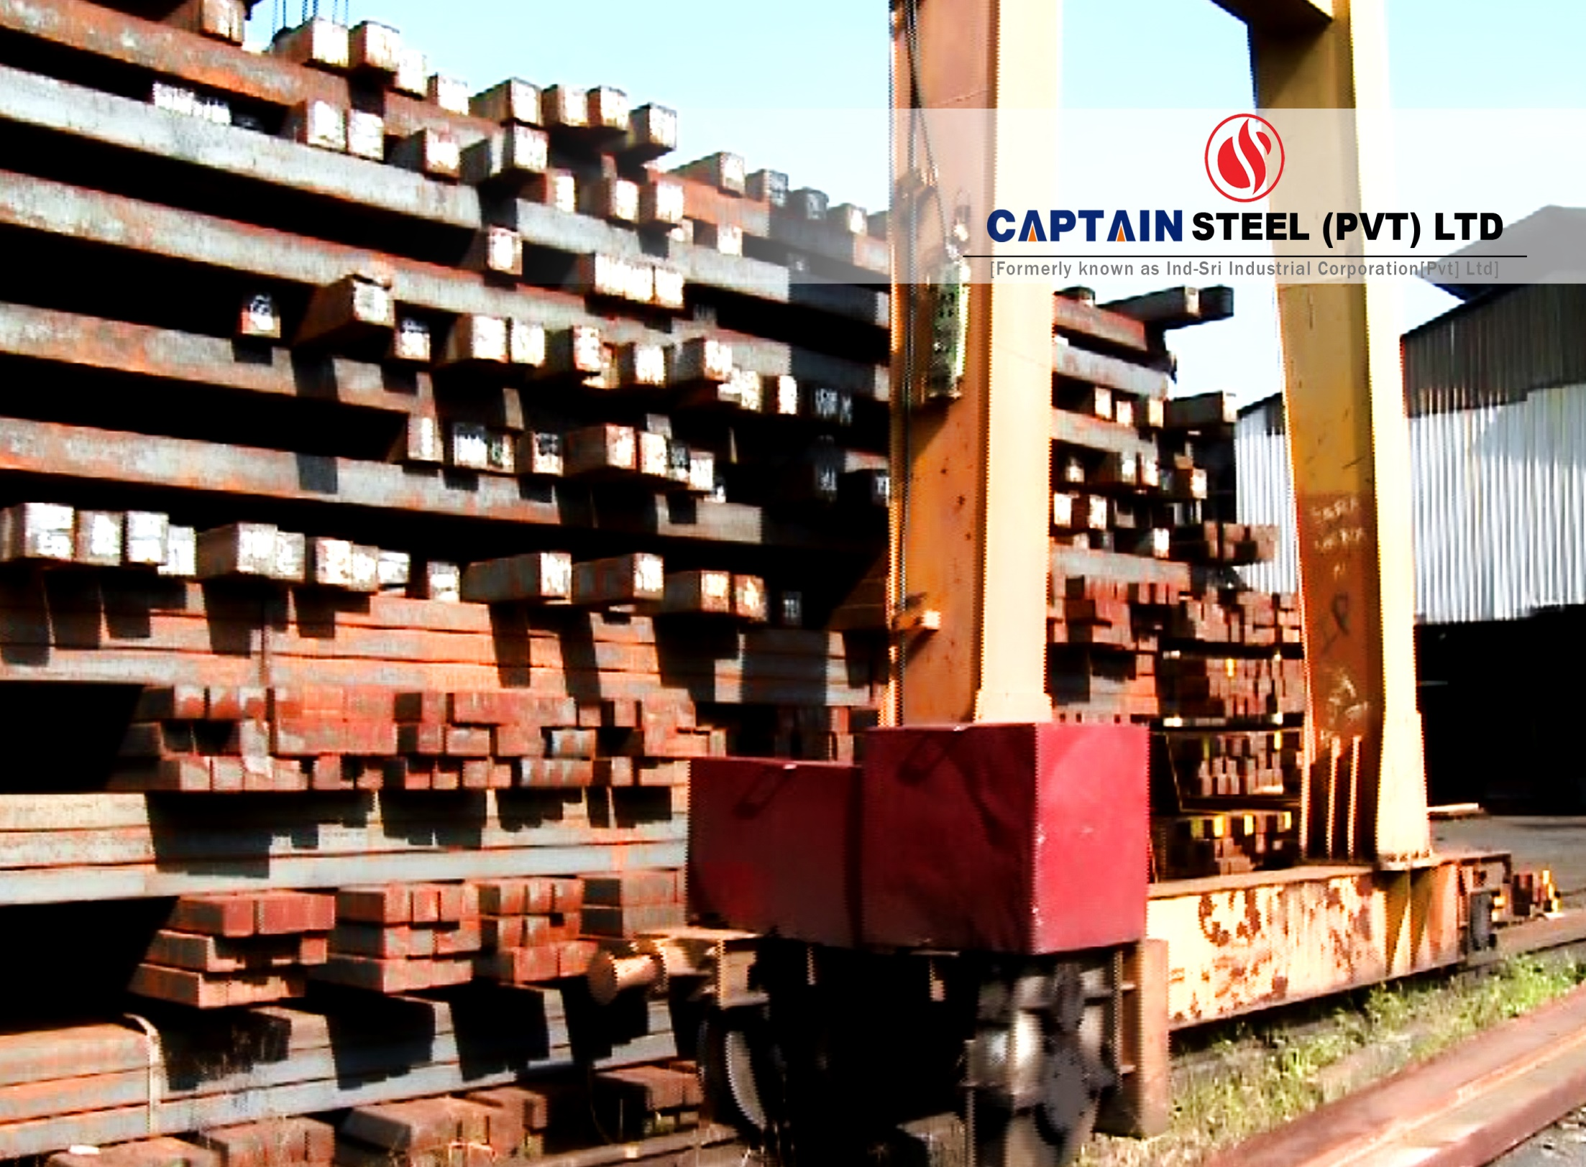

Slide 6
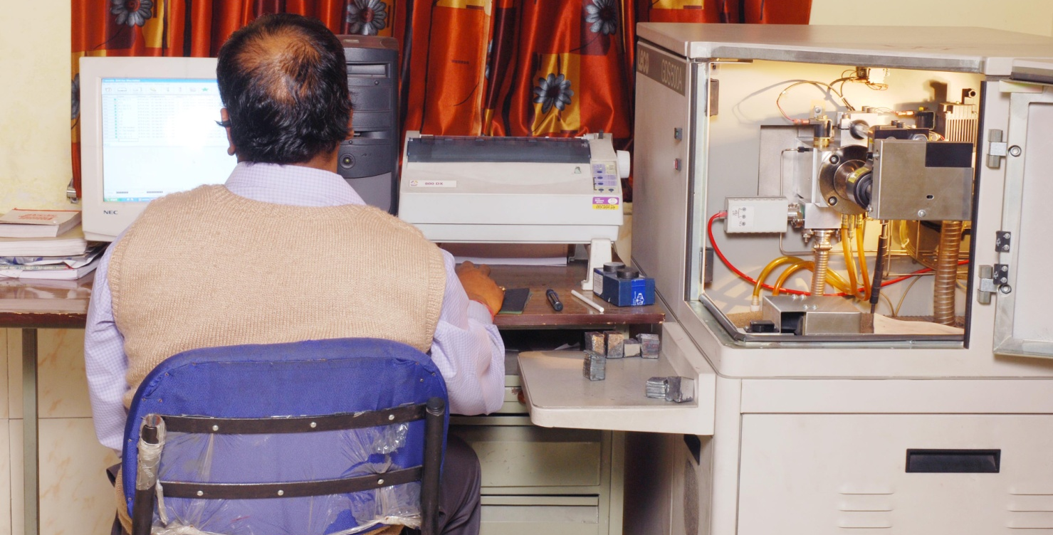
QCD
Testing of billet’s chemical composition by Spectrometer.

Slide 7
BILLETS
Chemical Analysis
C | 0.22%(Max)
S | 0.035%(Max)
P | 0.04%(Max)
Mn | 0.5%-0.7%
Si | < 0.20%
CE | 0.3%-0.45%

Slide 8
Journey towards Rolling Mills
100 feet Chimney for Flue gas emission.
Full bearing mills for negligible sound.
Billets to oil fired furnace.
Hot billets to mills.
TMT through Quenching box.
Automatic cooling bed.
FG testing.
PLC automation.
Treated water recycling.
Ambient cooling.

Slide 9
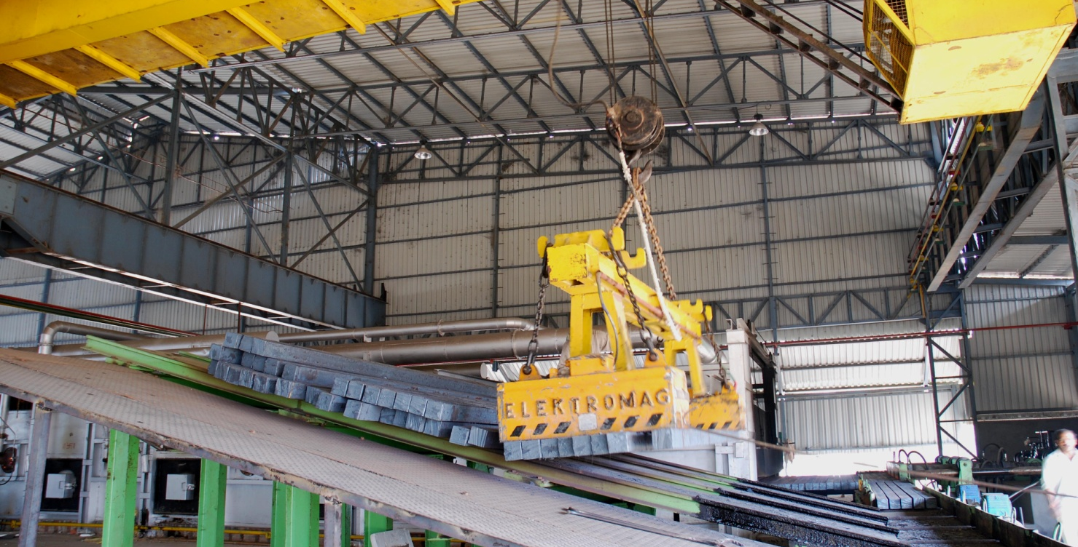
RMD
Charging of billets to RMD re-heating furnace

Slide 10
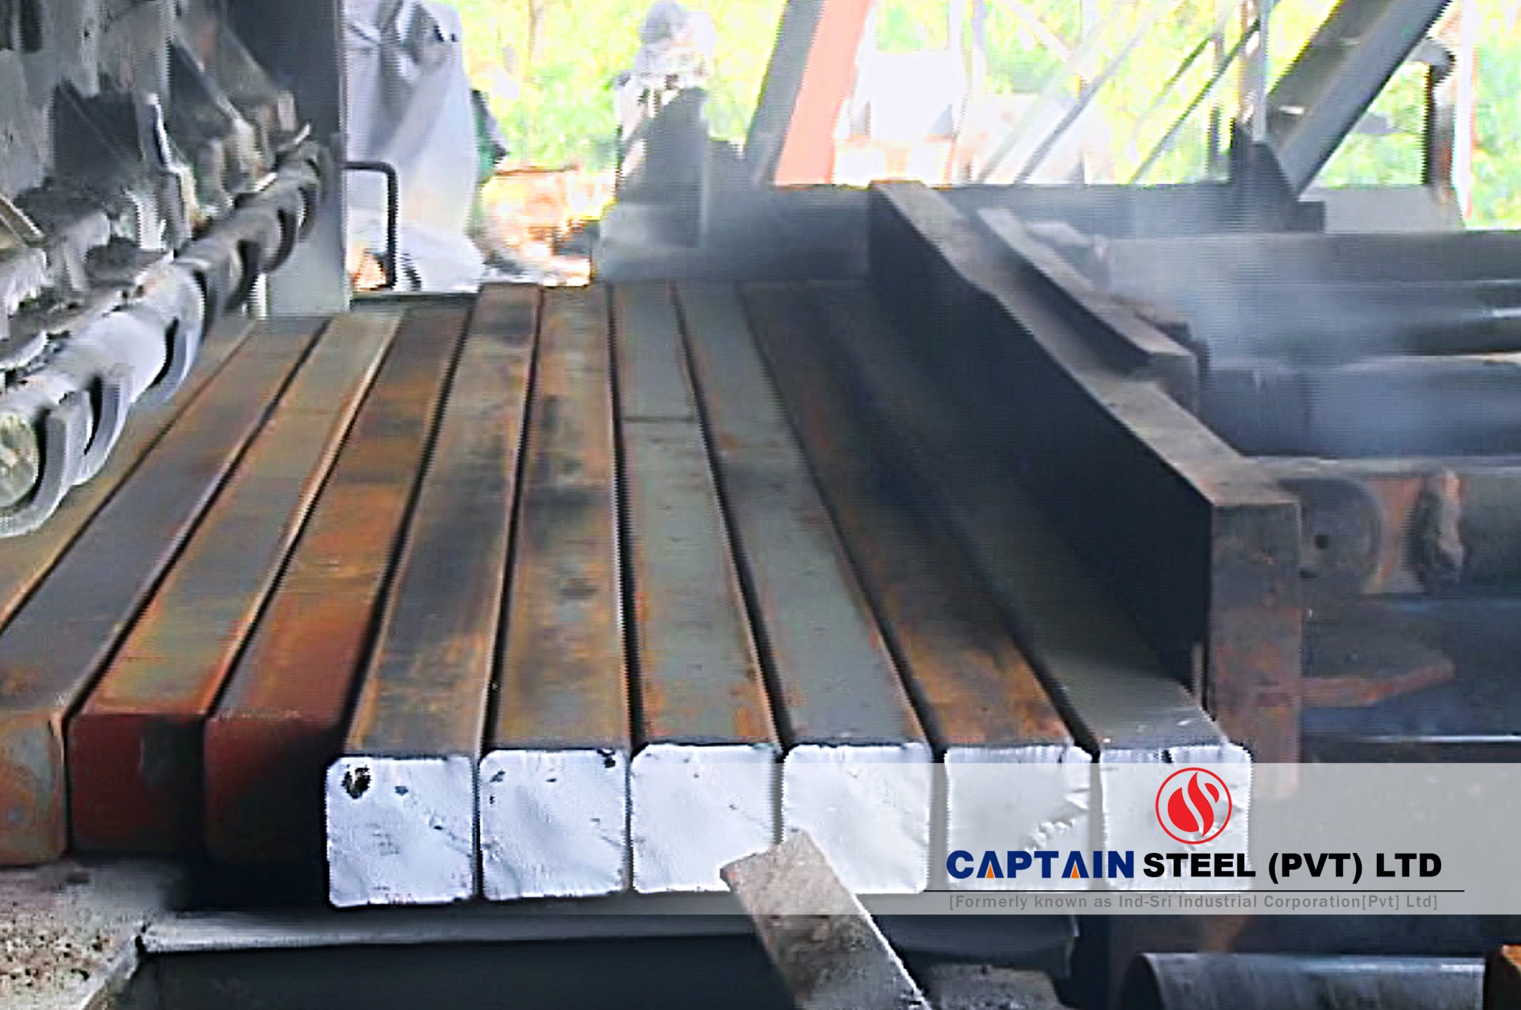

Slide 11
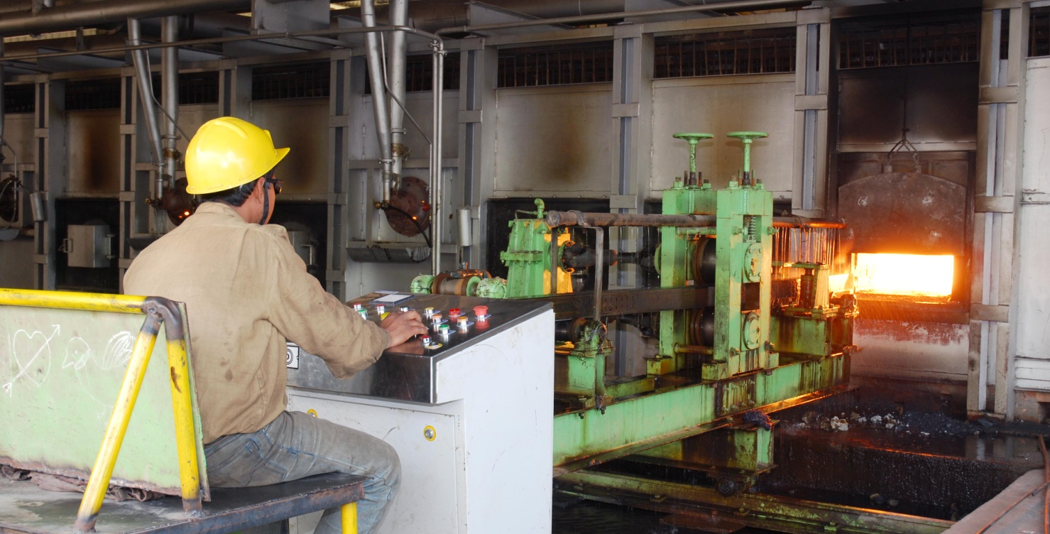
RMD
Oil fired furnace is preparing the 2.5 M (x 2) long 130mm billets in rolling condition by heating approx 1170ᴼ C at its Soaking Zone. The ready billets are being discharged by the help of Ejector.

Slide 12
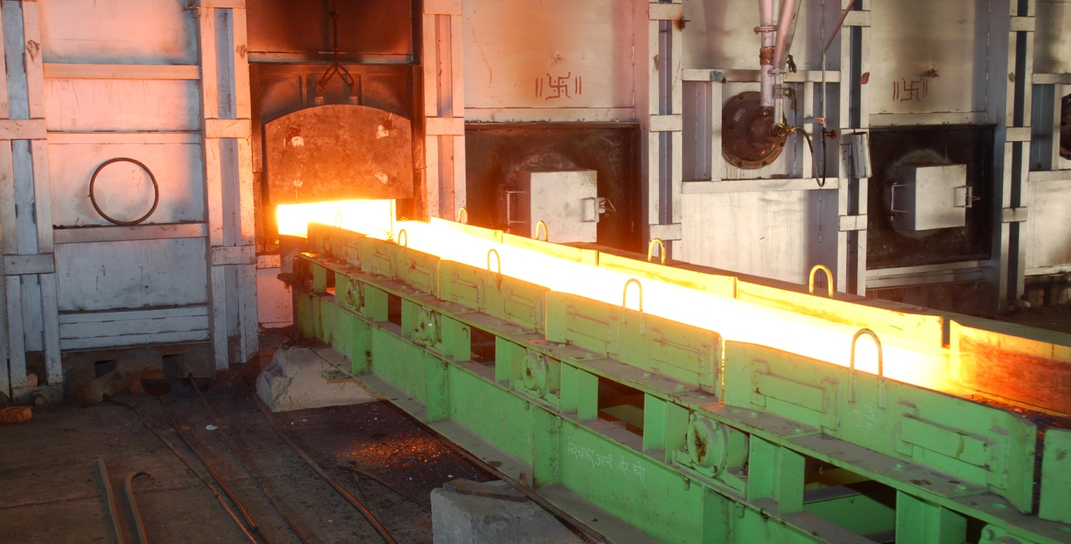
RMD
Red Hot billets are coming out of re-heating furnace

Slide 13
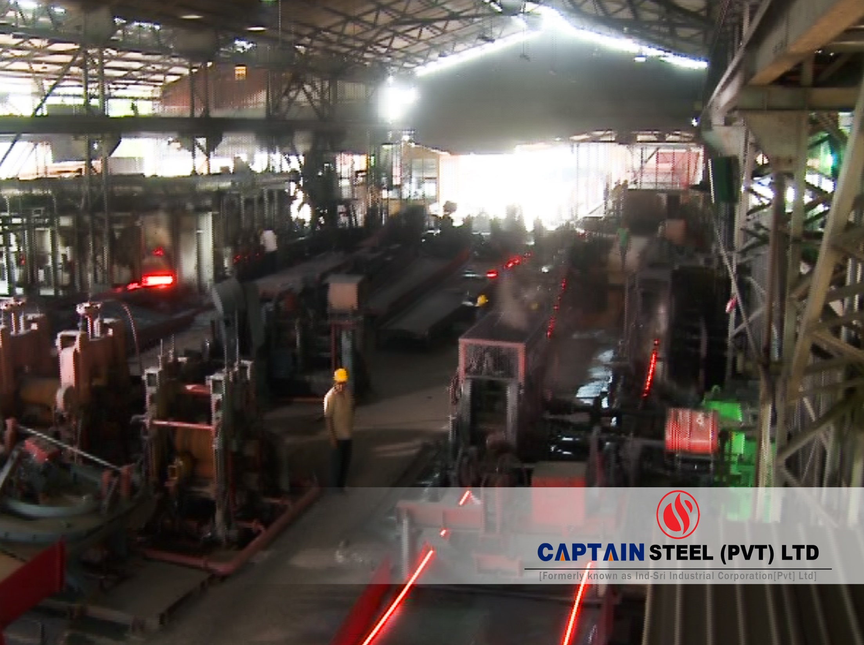

Slide 14
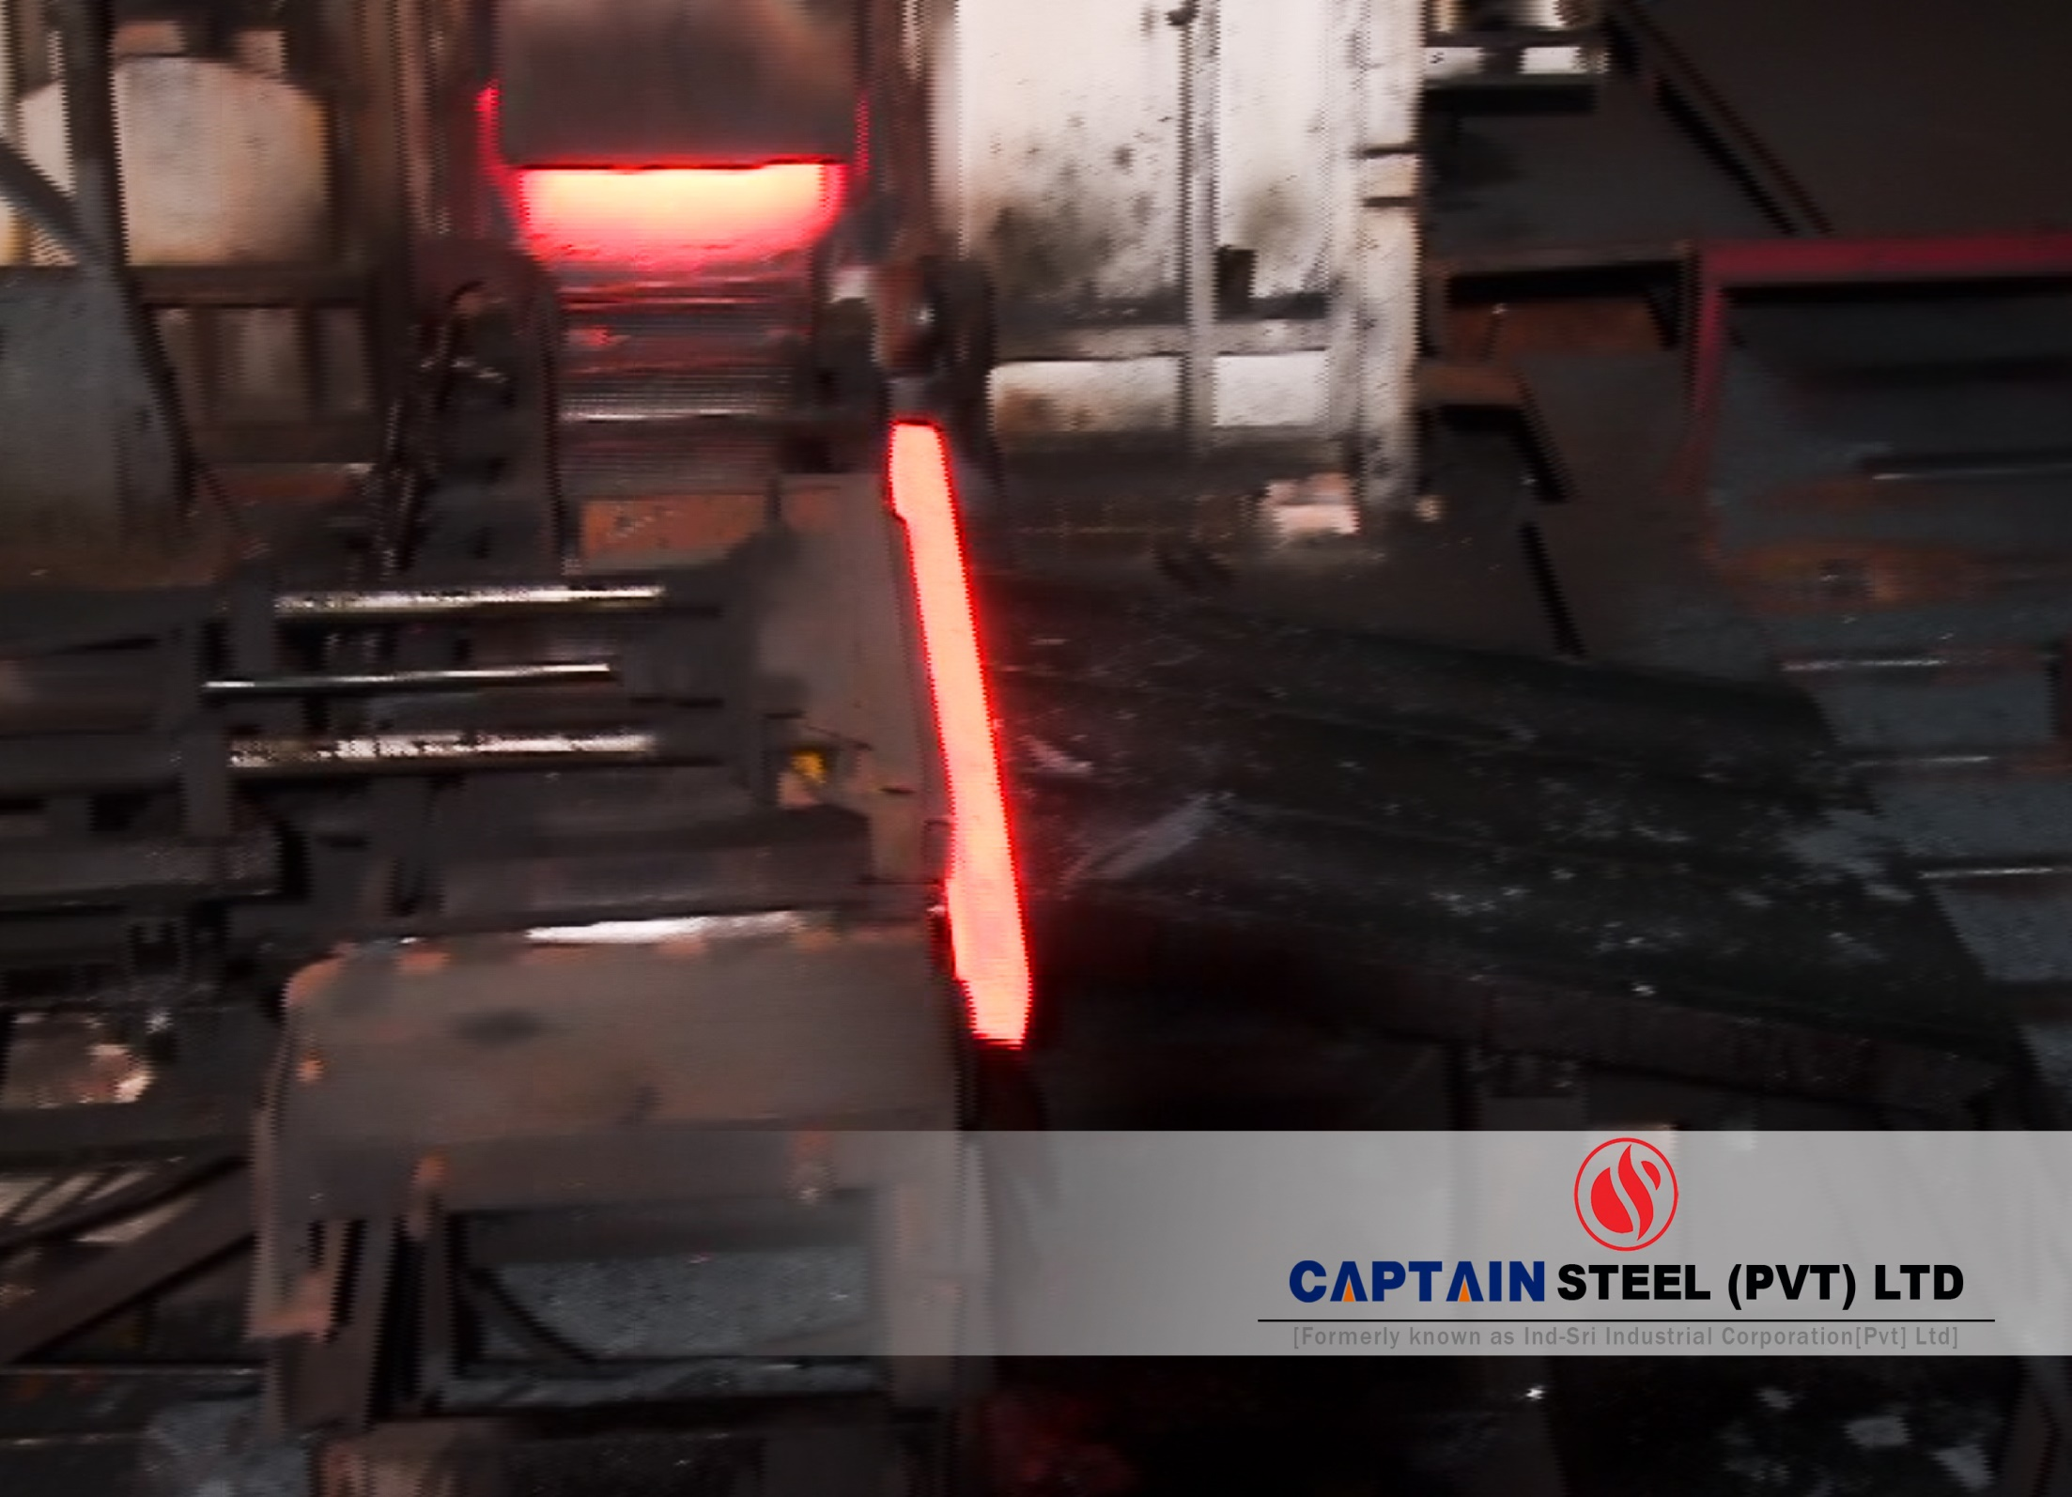

Slide 15
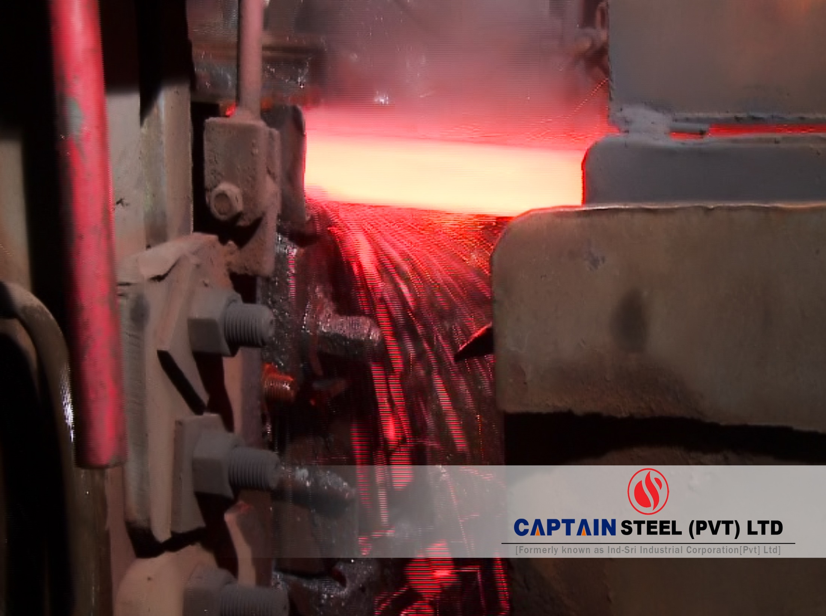

Slide 16
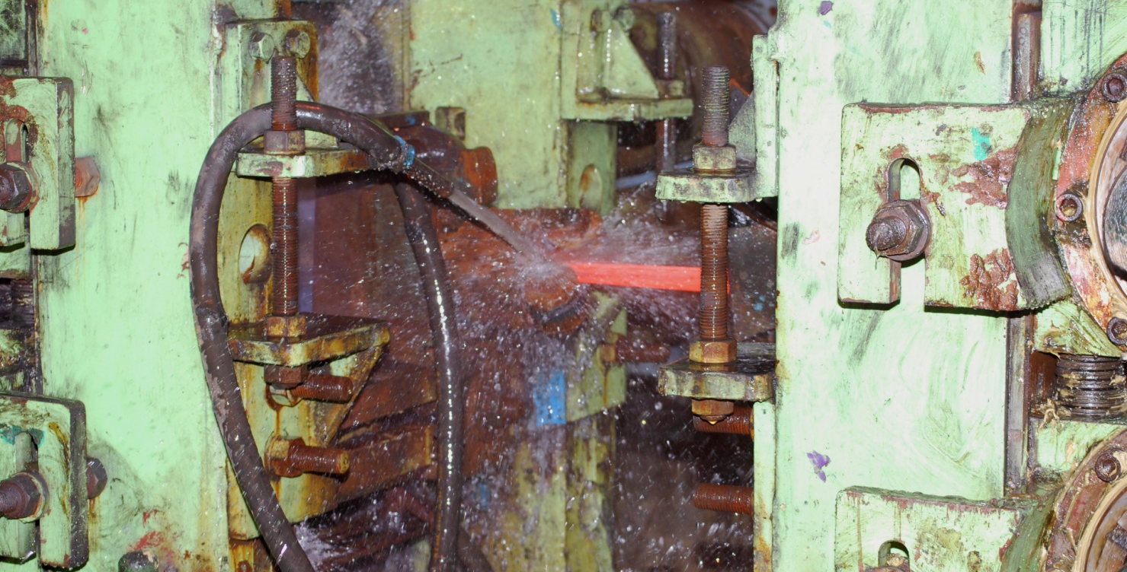
RMD
Material passing one stand to other in continuous mills.

Slide 17
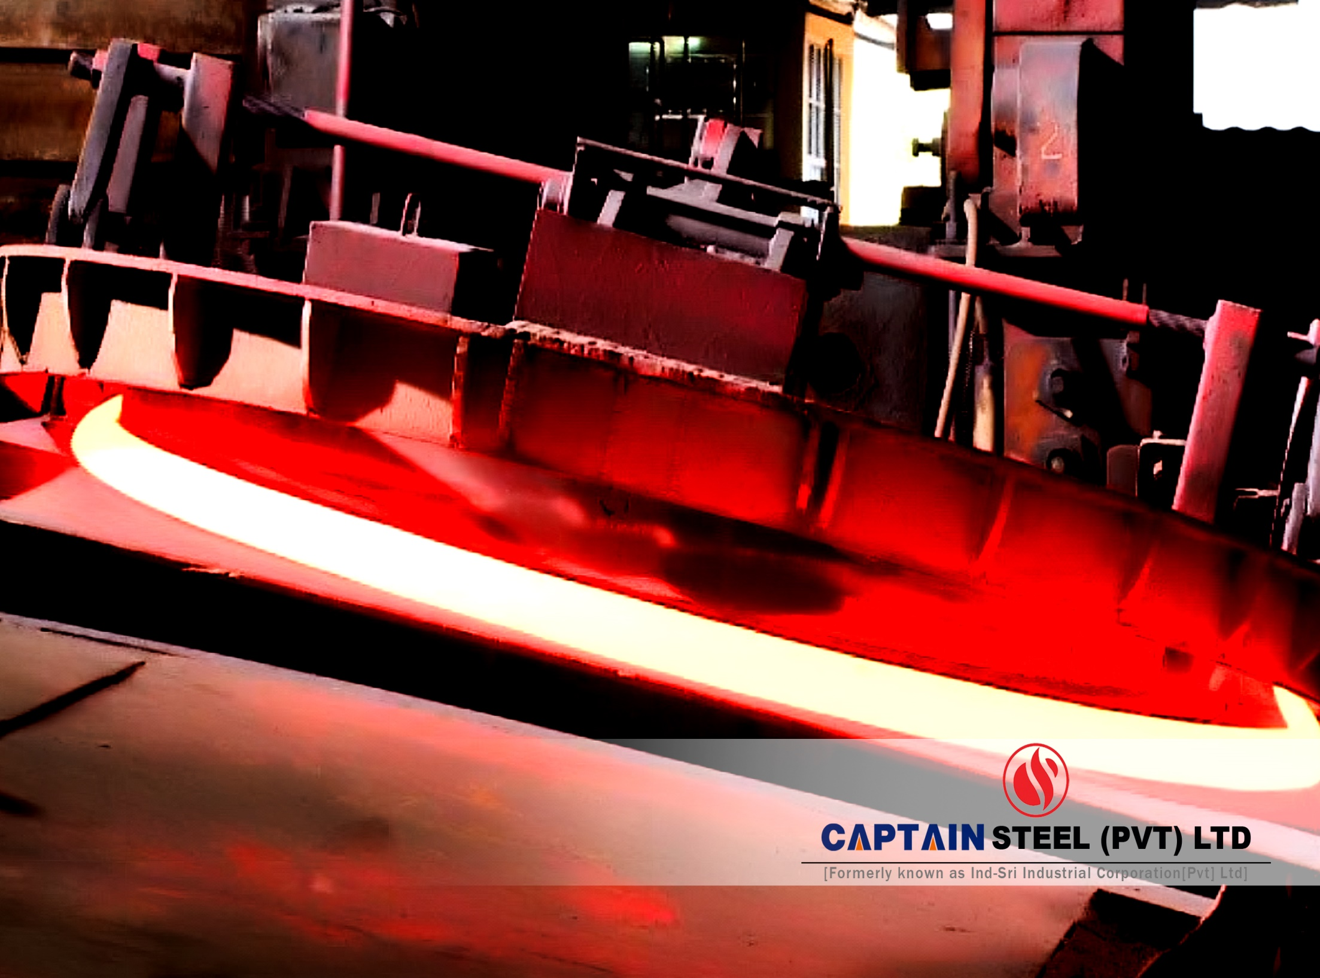

Slide 18
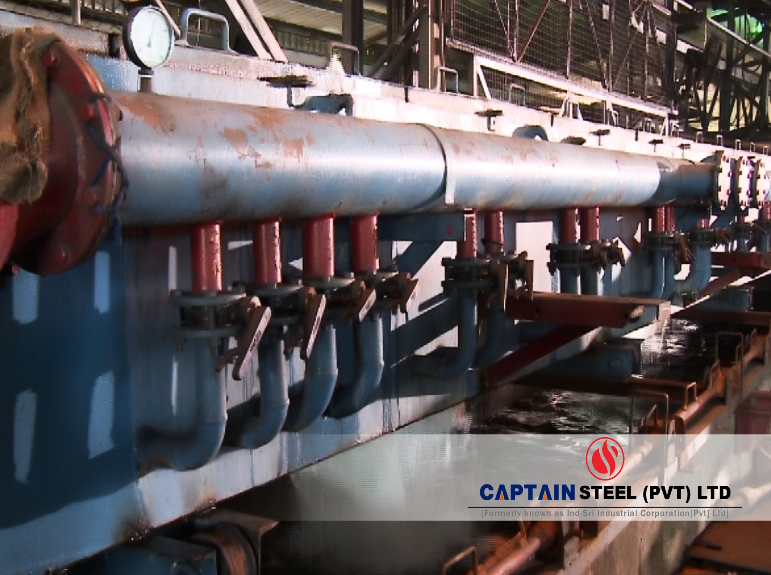

Slide 19
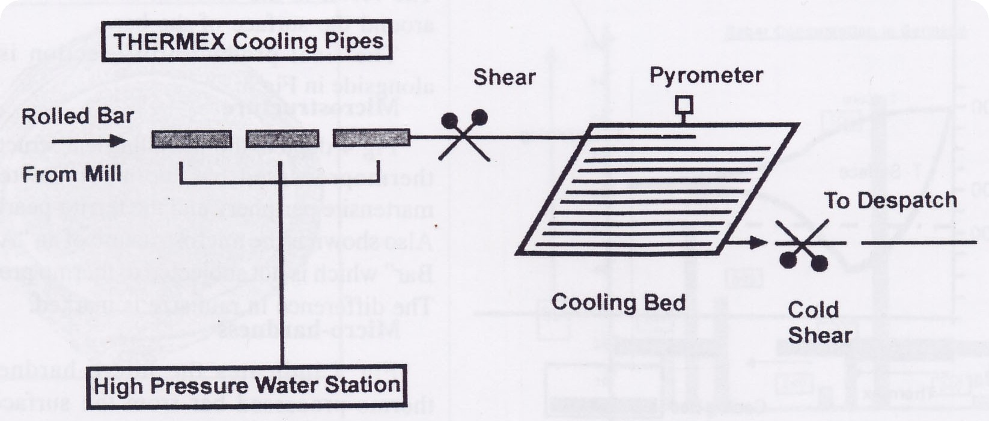
Tmt system
COMPLETE TMT SYSTEM

Slide 20
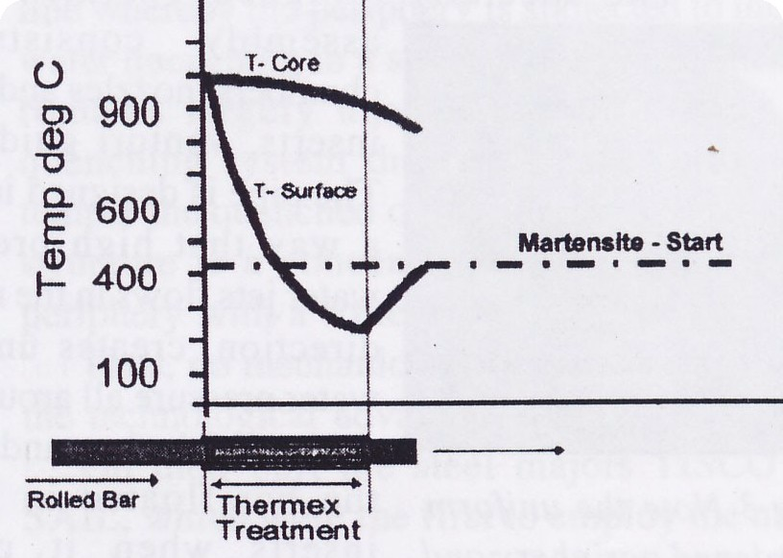
TMT THEORY
ROLLED BAR TMT TREATMENT
TMT TREATMENT GRAPH

Slide 21
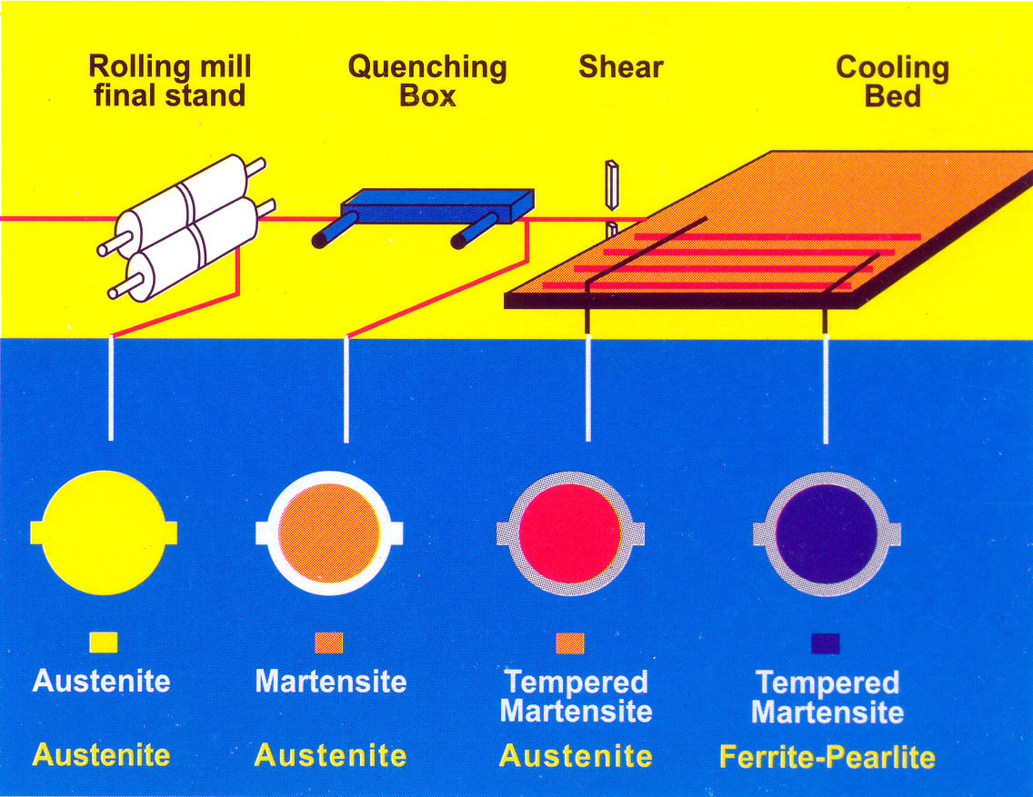
Phase Changes During The Process

Slide 22
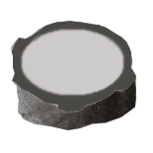
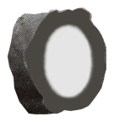
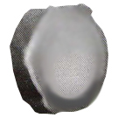
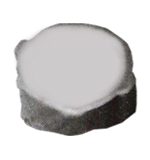
TMT Bars
These quenched and tempered martensite rebars have a uniform hardened tempered martensite periphery(15-30 per cent of area)with softer ferrite pearlite core and are good for civil construction.
This is an “over quenched ” bar.The hardened periphery is about 60% of the cross section area.Such bars will have poor ductility and are bad for civil construction
This shows a non-uniform hardened periphery.Owing to incorrect mill operation or an improper quenching system, quenching did not occur all around.Such bars are only to be used after extensive testing.
This is a bar produced by a bad quenching system or”hit and trial”TMT technology.Properties will vary widely from bar to bar and such bars should never be used in civil construction.

Slide 23
Inspection at TMT Plant
Incoming material temperature
Water temperature
Water pressure
Outgoing material temperature
Linear speed of finished material
Equalising temperature at the cooling bed

Slide 25
270
250
230
HV
210
190
HARDNESS
170
150
130
770
710
650
590
530
470
410
SURFACE
N/mm2
CORE
TENSILE STRENGTH
25 mm TMT BAR
HARDNESS VS TENSILE STRENGTH
FIG INDICATES THE HARDNESS (HV) VS TENSILE STRENGTH TMT BAR FROM THE SURFACE TO CORE

Slide 26
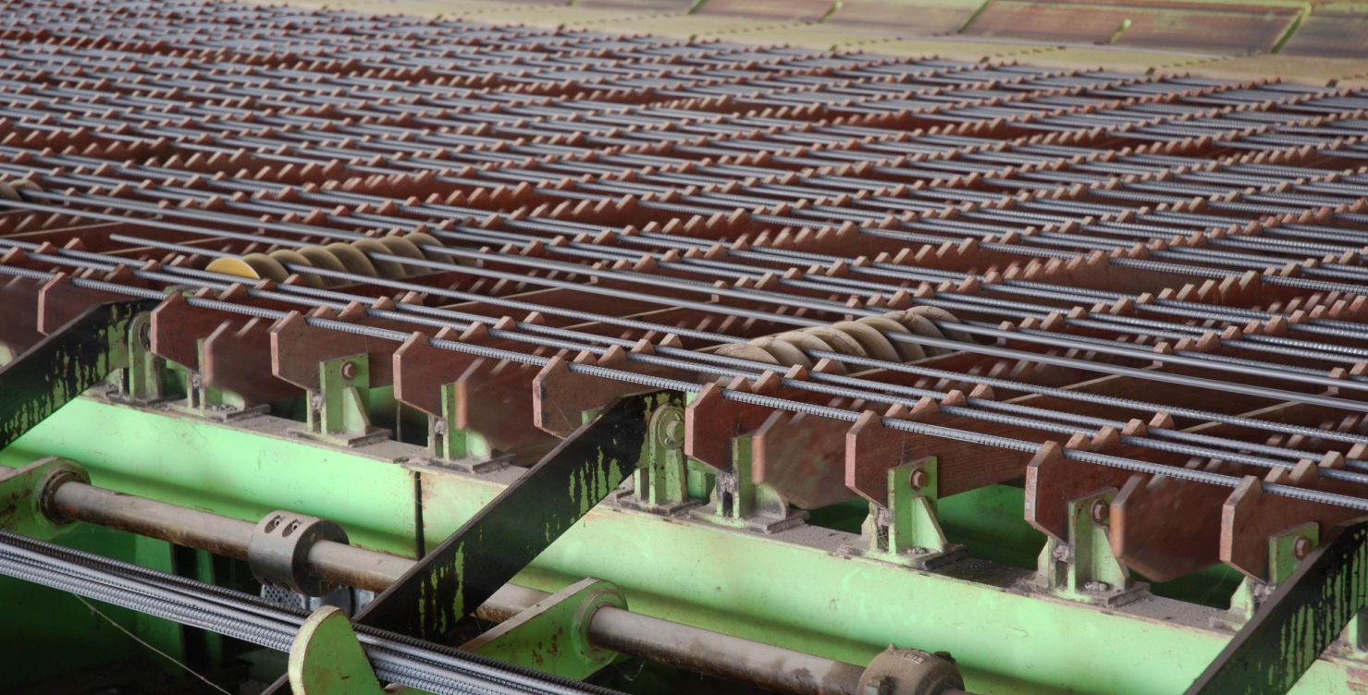
RMD
TMT are being transferred towards a roller track after ambient cooling. Finally cold TMT are travelling towards Cold Shearing Machine for cutting in 6 M to 12 M length.

Slide 27
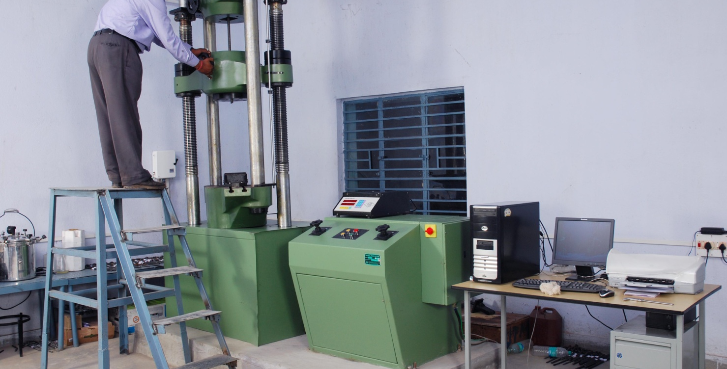
RMD - QCD
UTM – Tensely testing is under process before bundling for dispatch.

Slide 28
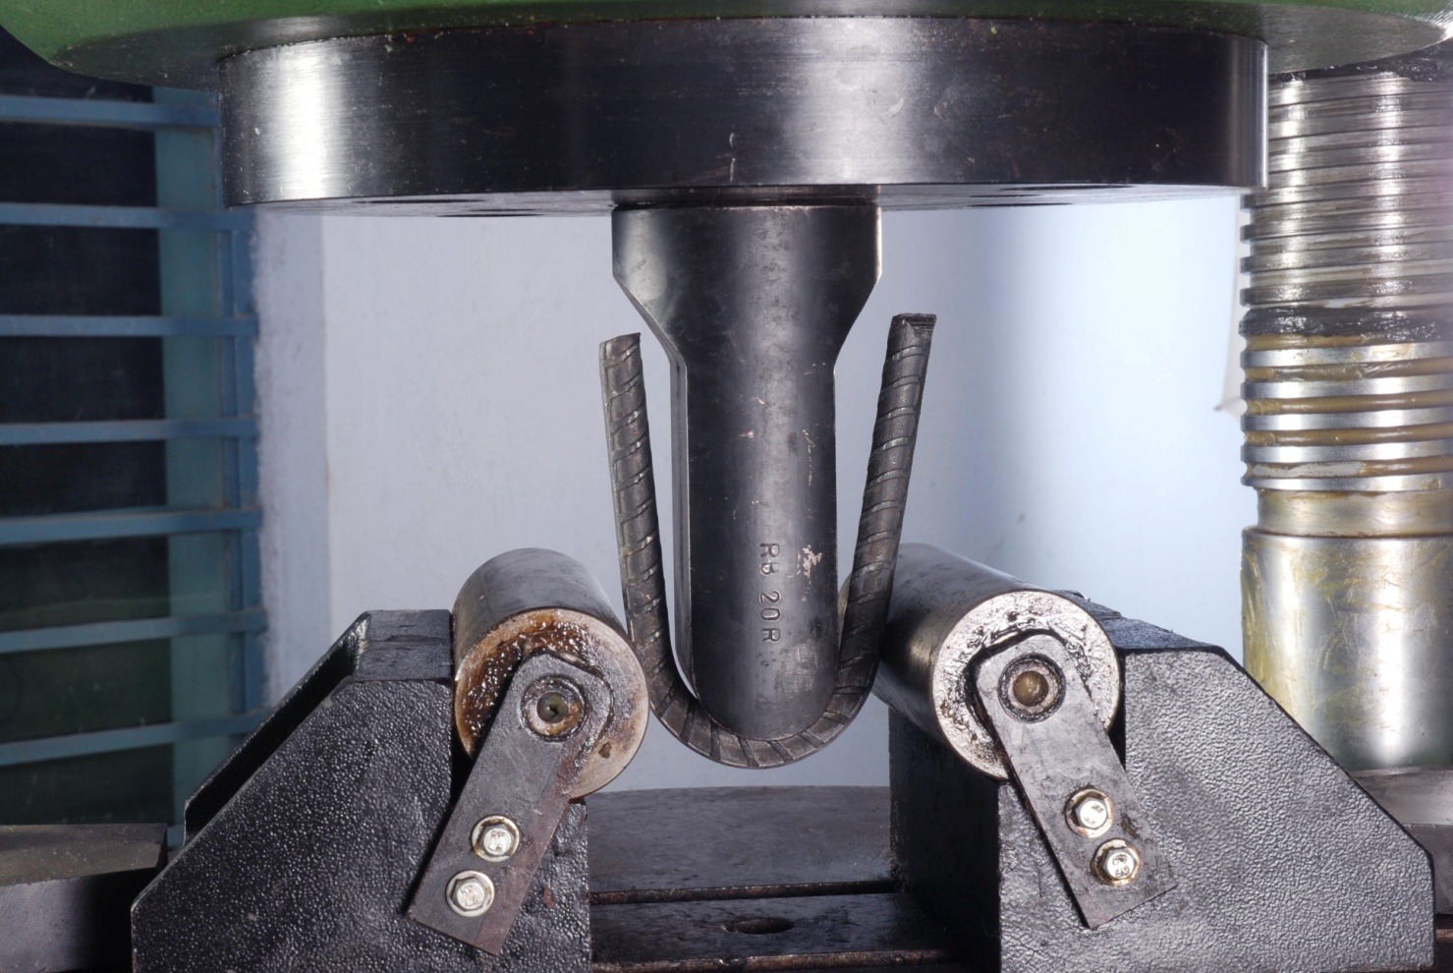
QCD - RMD
After proper testing (bend test), material are staging for despatch.

Slide 30
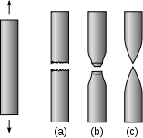
Notes:
High Ductility Test and Captain RB 500 results……………………………………………………..

Slide 31
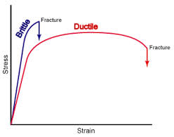
Notes:
Ductility curve of CAPTAIN RB500 ……………………………………………………………….

Slide 32
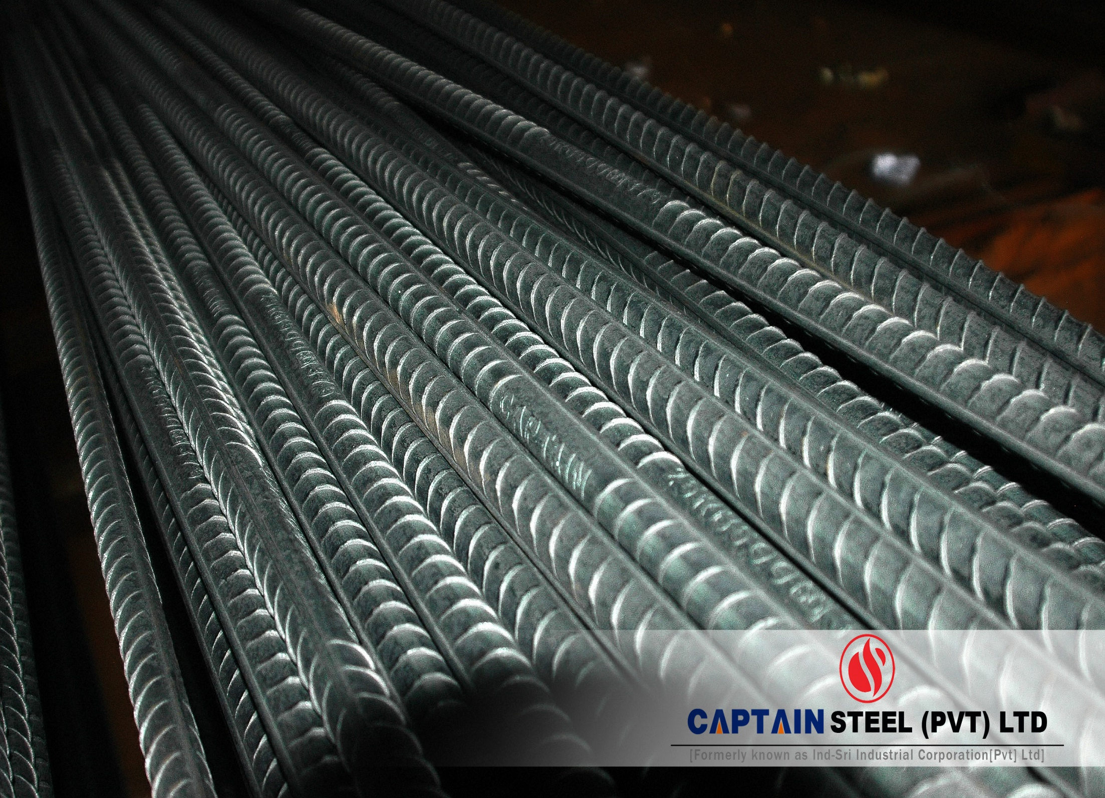

Slide 33
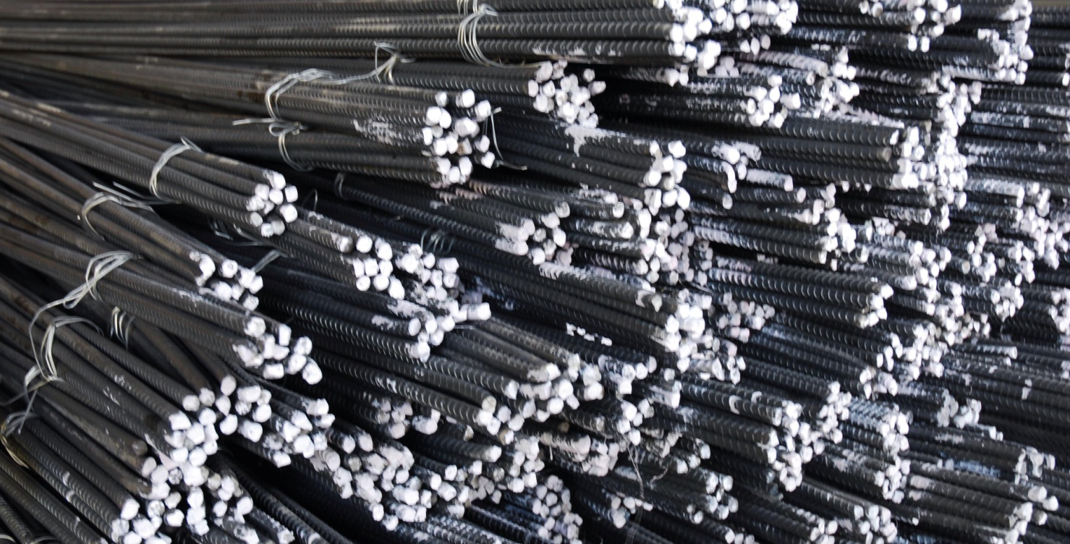
DISPATCH SECTION
Bundling as per required numbers of bars & section

Slide 34
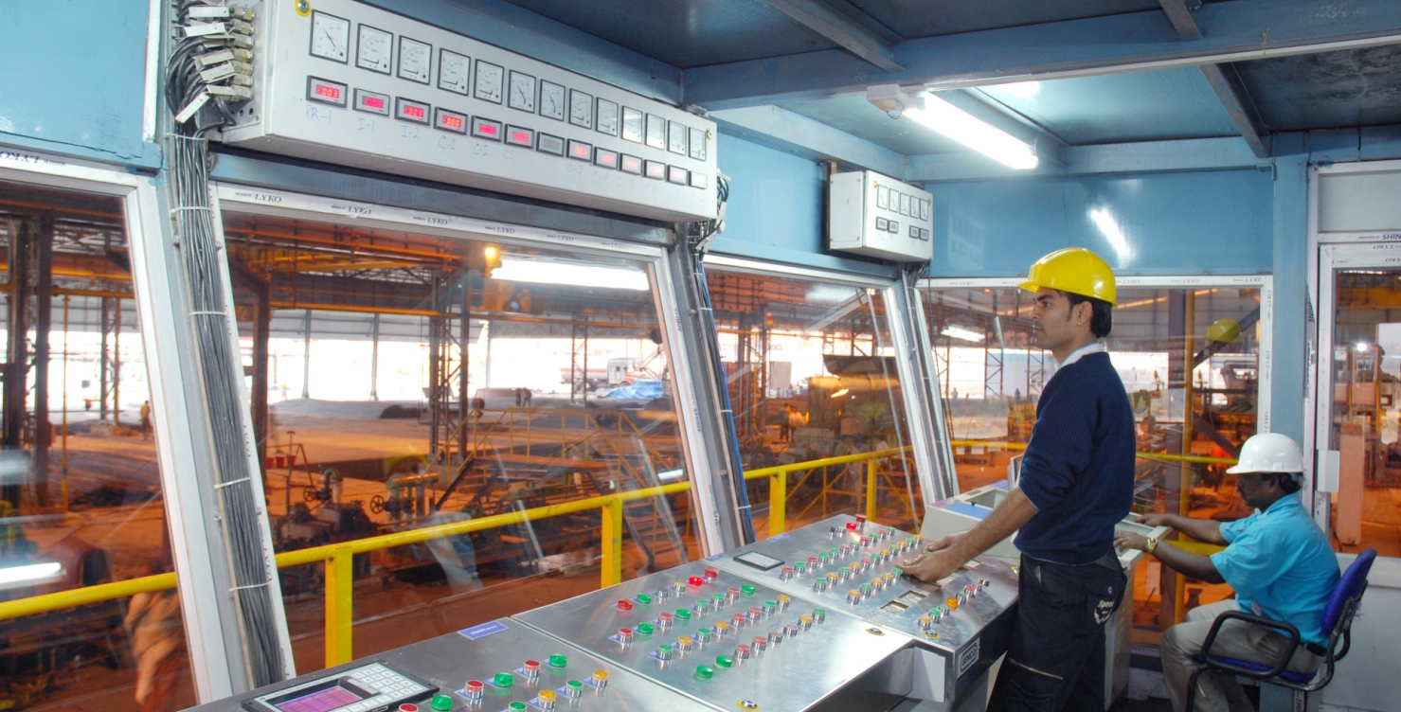
RMD – ELECTRICAL DEPT
Total operations are being controlled by pulpit operators, through PLC.

Slide 35
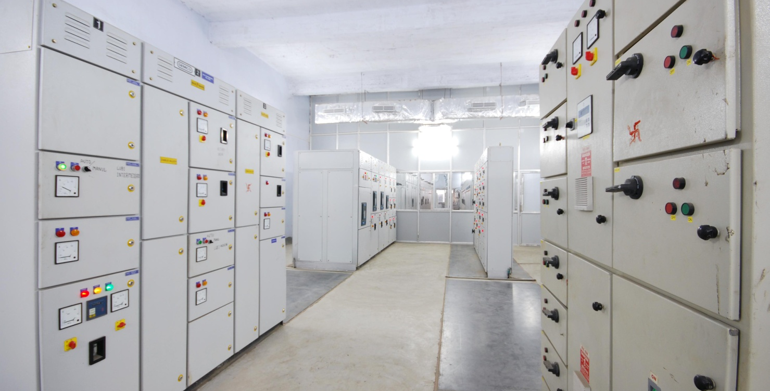
RMD - ELECTRICAL
“NELCO” make control panels (with collaboration of an Italian company) are installed for total rolling mills operation.

Slide 36
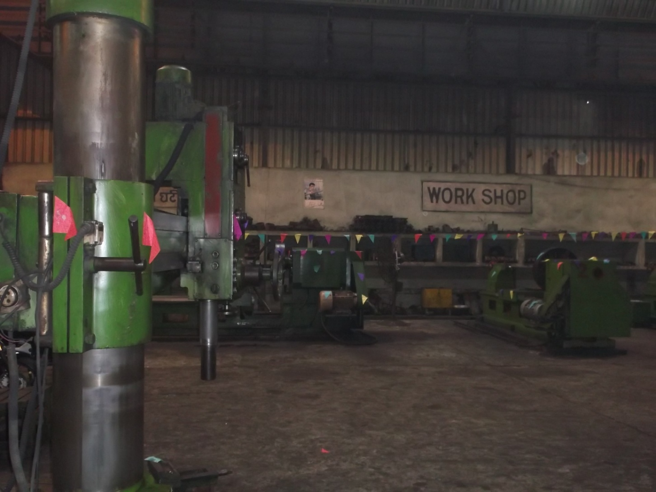
Most sophisticated Workshop for maintenance of RMD

Slide 37
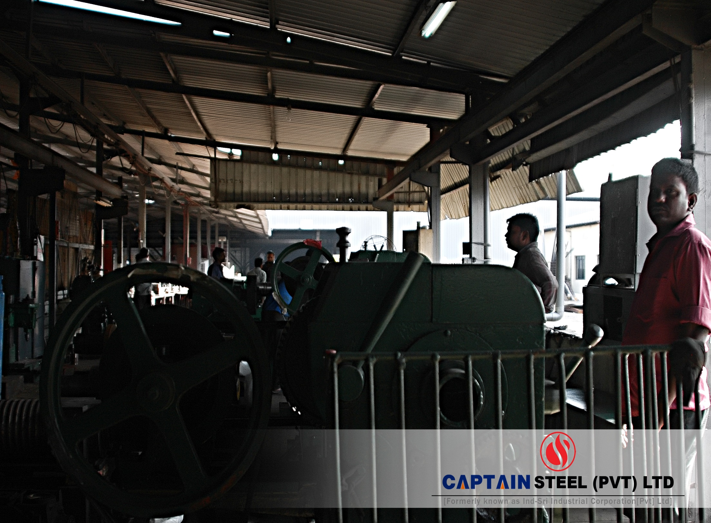

Slide 38
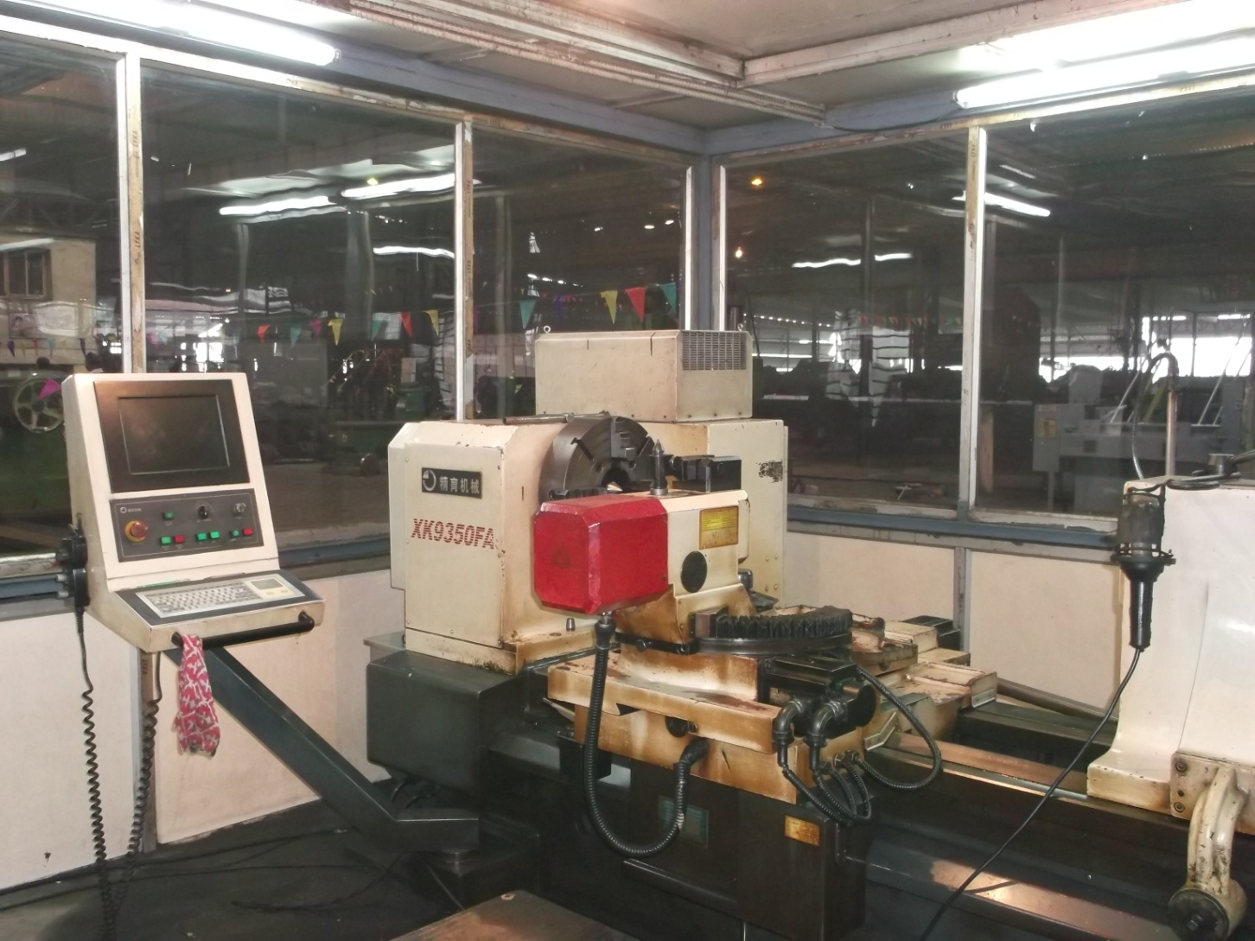
Impressions on the Rolls by CNC machine

Slide 39
Comparison of
TMT-BAR with others
Elongation | Y/s, N/m² | Remarks
18%-22% | 500-550 | TMT bar
36%-45% | 265-300 | Bars without Any treatment
32%- 40% Or below 6% | 360-390 Or 600 & above | Bars with inadequate/ Improper treatment

Slide 40
The 7 C’s Of THE “CAPTAIN” PARIVAR
Common - Purpose, Goal
Control - Leader
Context - Why ?
Capabilities
Commitment
Collaboration
communication

Slide 41
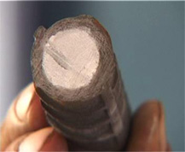
WHY CAPTAIN TMT IS BETTER ?
CAPTAIN TMT bars are produced with global Turbo Quench Technology from GERMANY. It conforms to all National and International standards. The Best combination of chemical & physical properties is the main characteristic of CAPTAIN TMT. Strict Quality Control is maintained at each level of production. CAPTAIN TMT bars are of uniform strength, elongation and enhanced ductility that is far in excess of minimum limits specified in the SLS standard . As per the SLS and practically used by designers bars require minimum yield strength of 500 N/mm². However CAPTAIN TMT bars possess typical yield strength as high as 525 & 550 N/mm². Further as per BS/SLS standard ductility as measured elongation is specified to be 14.5 % which is tested to be 18 % in case of CAPTAIN TMT. Hence the bars produced with international technology are much better than traditional cold twisted deformed (CTD) bars.

Slide 42
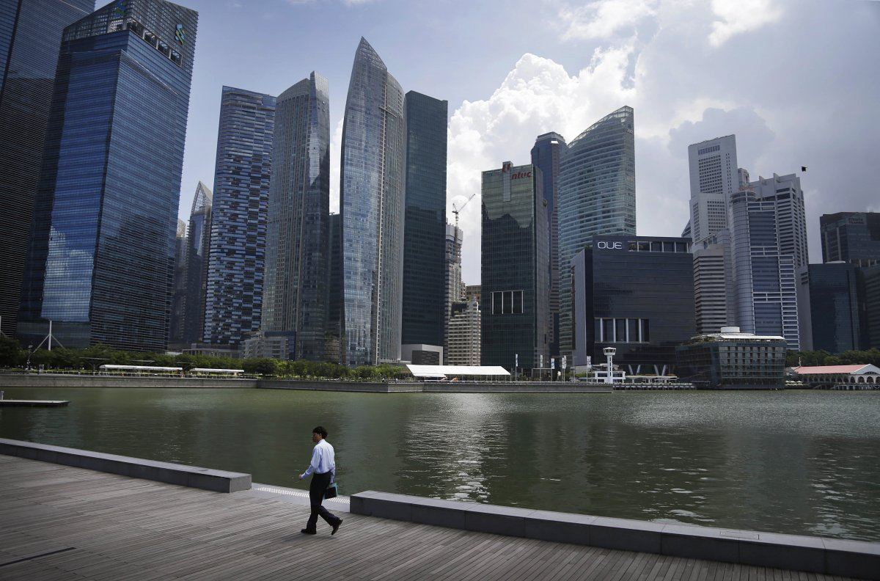
Notes:
“ LESSER GROUND OCCUPIED BUT HIGHER ACCOMMODATION OBTAINED DUE TO SKY SCRAPERS “

Slide 43
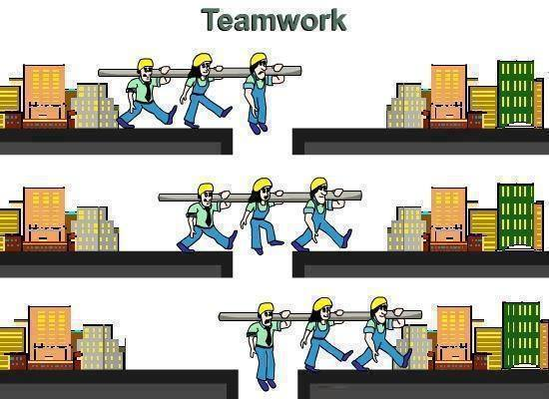

Slide 44
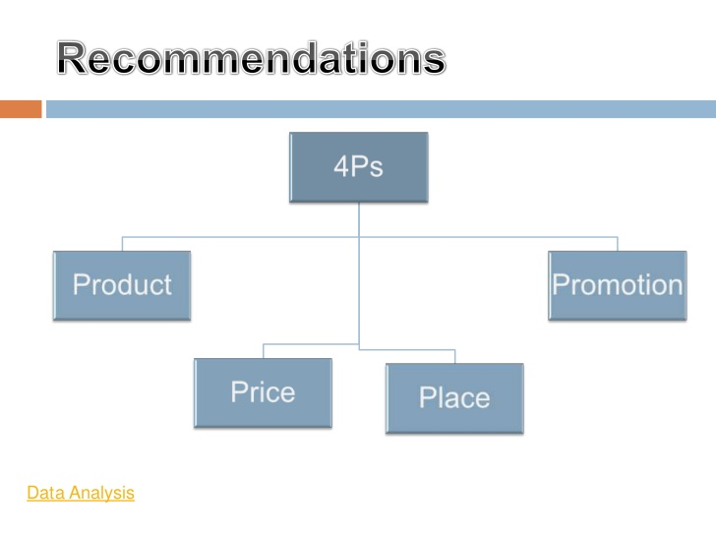

Slide 45
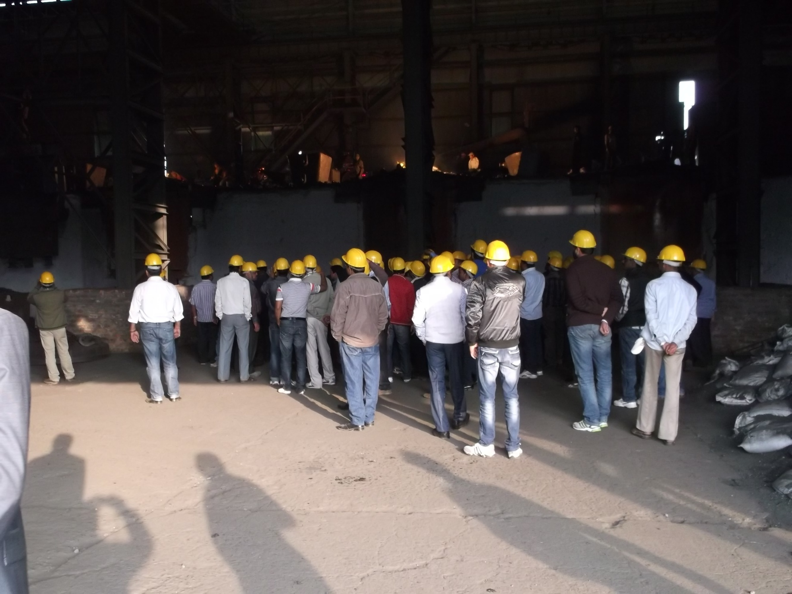

Slide 46
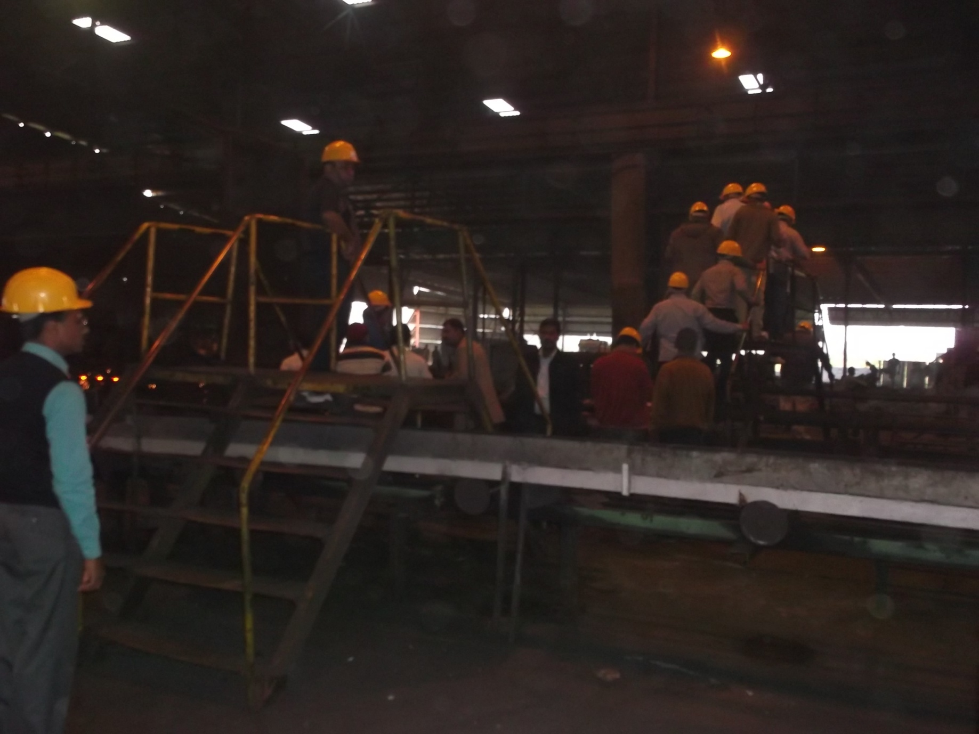

Slide 47
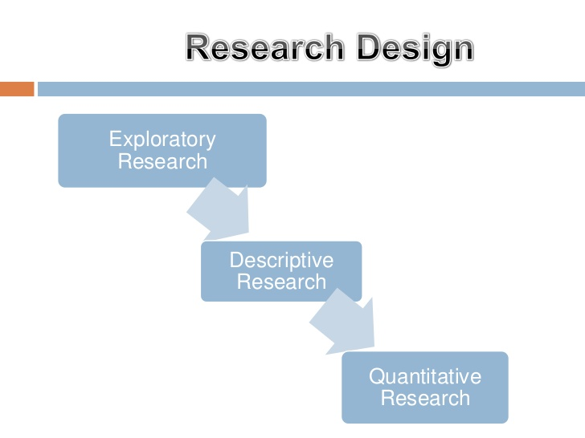

Slide 48
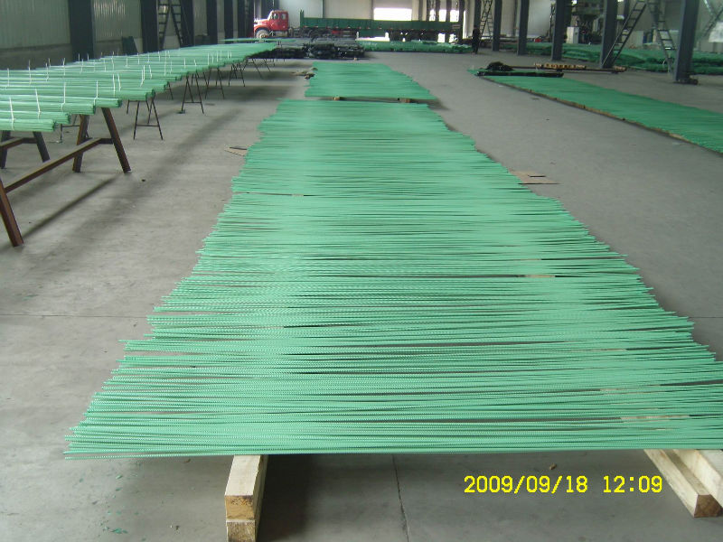
THANK YOU
“We will request our dealer/distributor to make an arrangement for visit of our plant to establish the realistic pointer view of this presentation”

Slide 50
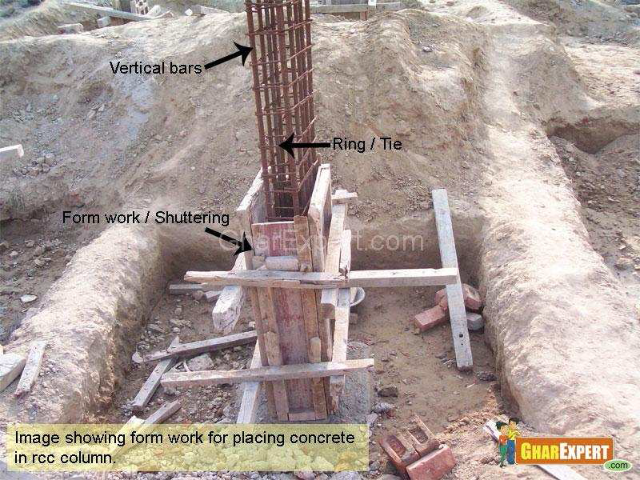

Slide 51
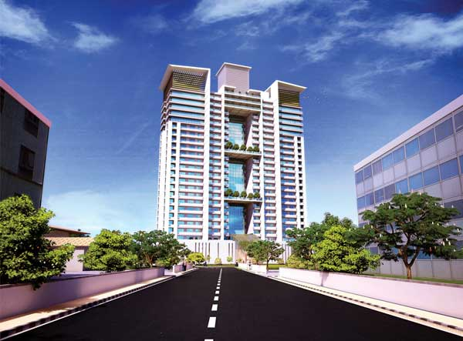

Slide 52
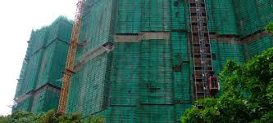

Slide 53


Slide 54
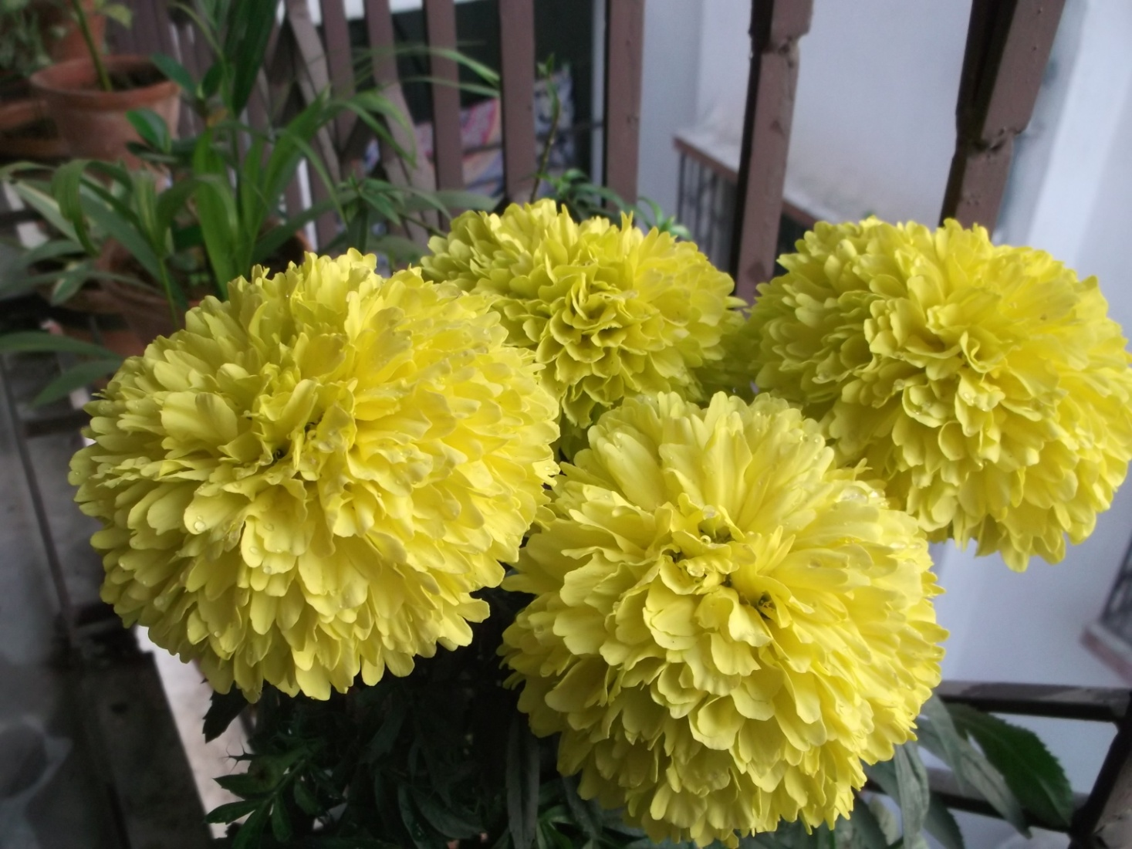
“Wish you be safe in life with CAPTAIN TMT bars” Thank you.

